Slide 1

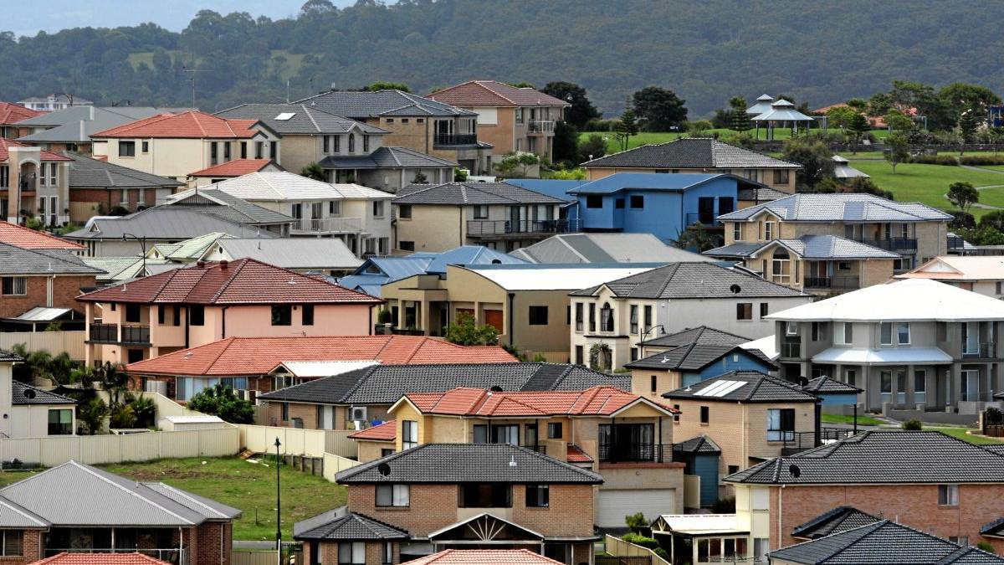
Melbourne Housing Market
Predicting Housing Price
using
Linear Regression Model
By: Aniruddha Bose
Mentor: Ryan Rosario

Slide 2

Agenda
Background & Overview
About Data
Data Management
Data Visualization
Regression Analysis
Checking Multicollinearity
Impact of Categorical variables
Summary
Conclusion
Model Diagnostics
Future scope of improvement

Slide 3

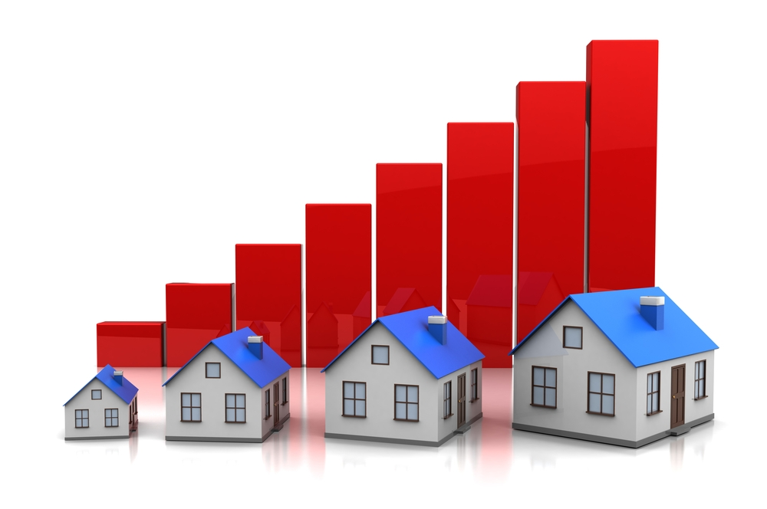
Background & Overview
Melbourne, Australia is currently experiencing a housing bubble (some experts say it may burst soon). People living in Melbourne are interested to know the trend or price prediction of the properties located in Melbourne and its suburbs.
Which suburbs/regions are the best to buy in?
Which ones are value for money?
Where's the expensive side of town?
And more importantly where should an individual buy a 2-bedroom unit which is not that far Central Business District of Melbourne

Slide 4

About Data
Data is readily available on a number of measures, including size of the land, location, age of the property, number of rooms, number of bathrooms, number of cars that can fit into the garage and distance from CBD. The data set contains information of 12K+ residential properties sold during a recent 18-month period.
Variables | Description
Price | Selling price of the property in AUD (Australian Dollar
Suburb | A suburb is a residential area or a mixed use area, either existing as part of a city or urban area or as a separate residential community within commuting distance of a city.
Address | Address of the property
Rooms | Number of rooms in the house
Type | Type of the Property. h - house, cottage, villa, semi, terrace; u - unit, duplex; t - townhouse; dev site - development site; o res - other residential
Method | The process is which the property has been sold S - property sold; SP - property sold prior; PI - property passed in; PN - sold prior not disclosed; SN - sold not disclosed; NB - no bid; VB - vendor bid; W - withdrawn prior to auction; SA - sold after auction; SS - sold after auction price not disclosed. N/A - price or highest bid not available.
Seller | Real Estate Agent
Date | Property Sold Date
Distance | Distance from CBD (Central Business District)
Postcode | Zip code of the Property where it is located
Bedroom | Number of bedrooms in the house
Bathroom | Number of bathrooms in the house
Car | Number of cars that can fit into the garage
Landsize | The size of the property plot
BuildingArea | Area of the building in Sqft
YearBuilt | The year when this house was built
CouncilArea | Council is the area defined by Local Government
Latitude | Latitude and longitude are angles that uniquely define points on a sphere.
Longitude | Latitude and longitude are angles that uniquely define points on a sphere.

Slide 5

Data Management
The junk Suburbs’ records are removed by dropping meaningless Suburb named as ‘RE’.
The Properties having missing price have been removed from analysis.
Missing 'Landsize' of any Property has been replaced with ‘Median’ Landsize of the Properties in a Suburb. ‘Mean’ Landsize of the properties in a Suburb is not considered for the presence of extreme values which are nothing but outliers.
The date field (Property Sold Date) has been formatted from Australian standard (dd/mm/yyyy) to US standard (mm/dd/yyyy).
There are around 70 suburbs. If we consider all the suburbs for analysis, apparently the more useful the model would be however the opposite is actually true – it greatly weakens the model’s predictive analysis. Hence we decided to categorize the suburbs in 5 regions (East, West, North, South & Central). Prepared a dataset having Suburb name, City name and Region and finally merged with the original dataset.

Slide 6

Data Visualization
From our initial analysis, we think seven (7) of the predictor variables measure, directly or indirectly influence the price of the property
‘Size of the Land’
‘Number of Rooms’
‘Number of Cars that can fit into the Garage’
‘Distance from CBD’
‘Property Type’
‘Suburb Region’
‘Property Sold Date’
Among these 7 Independent variables ‘Property Type’ and ‘Suburb Region’ are considered to be Categorical or Dummy variables.

Slide 7
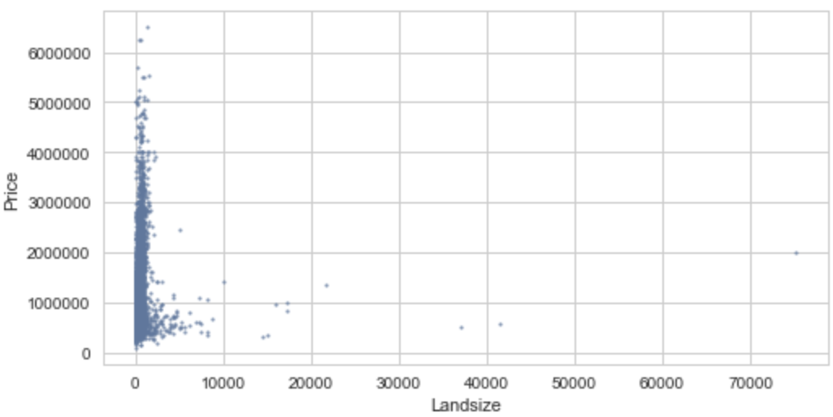
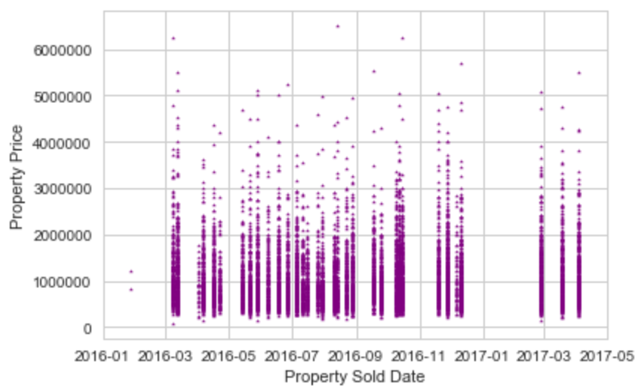
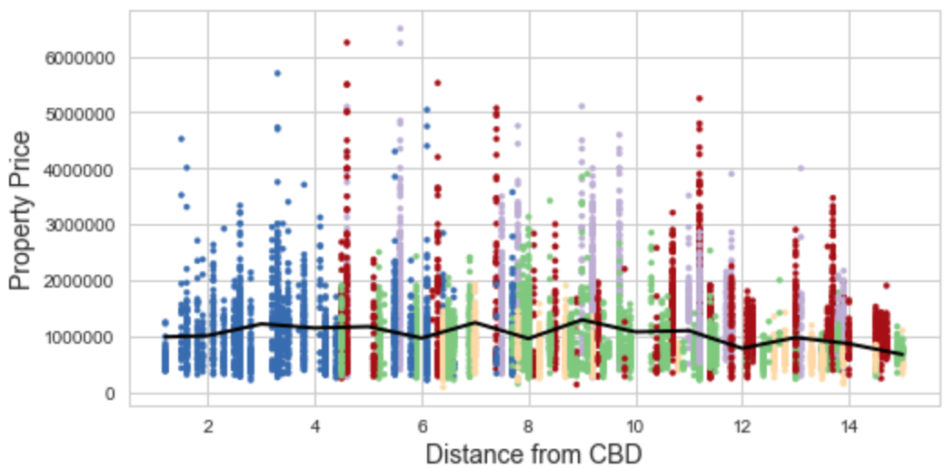
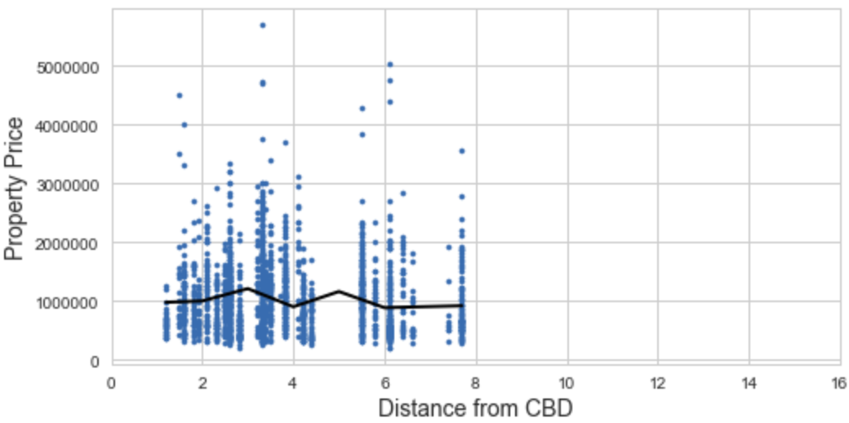
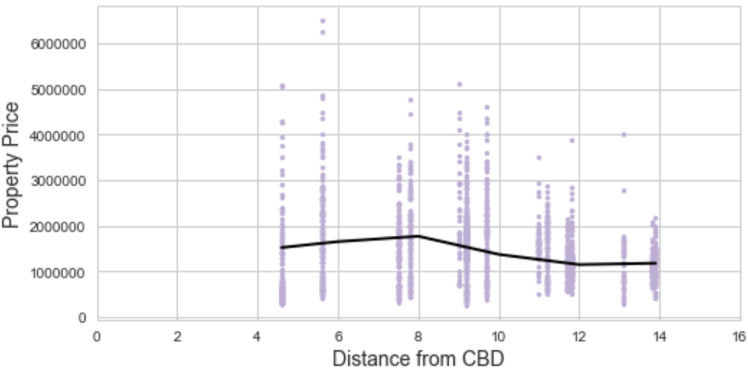
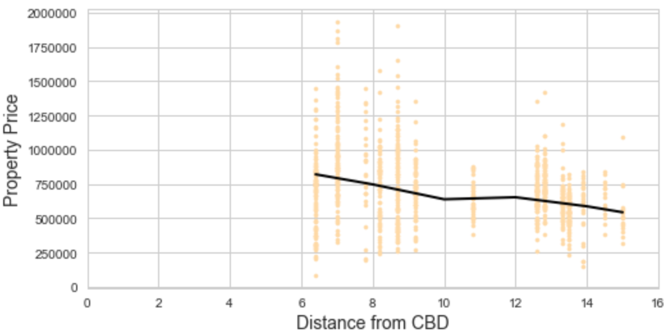
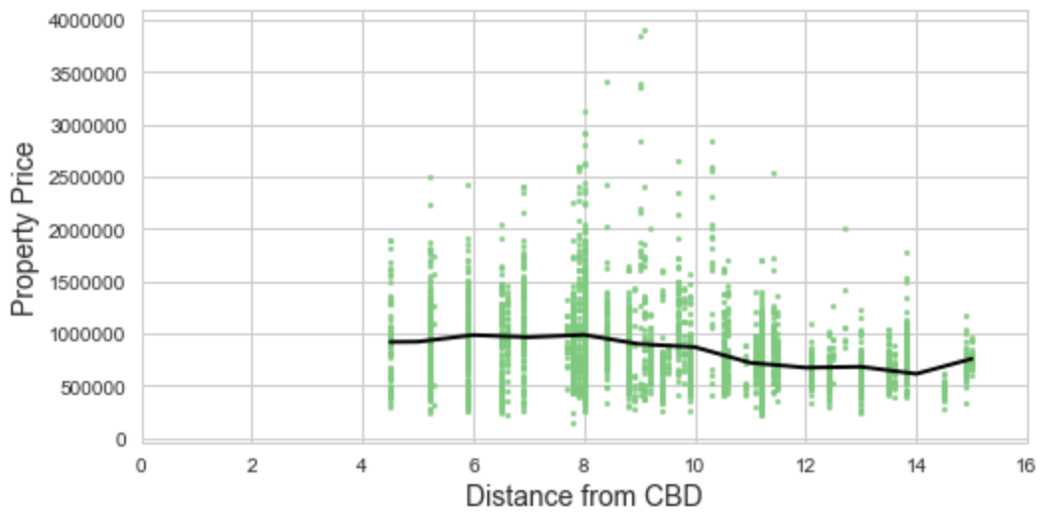
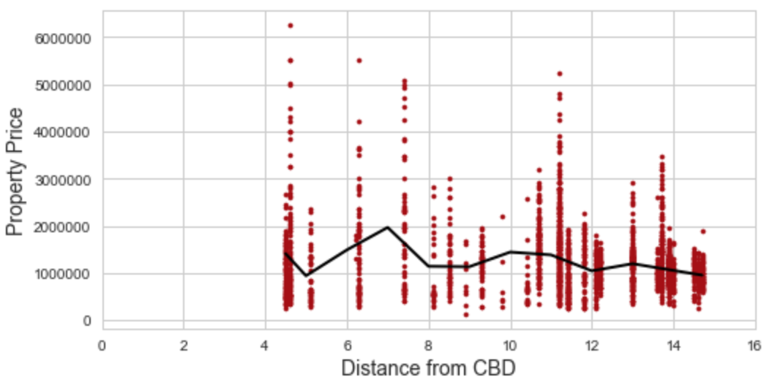
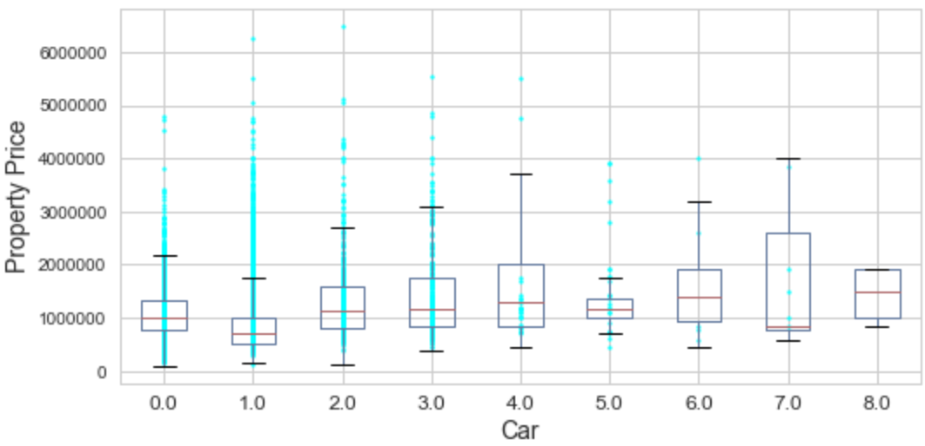
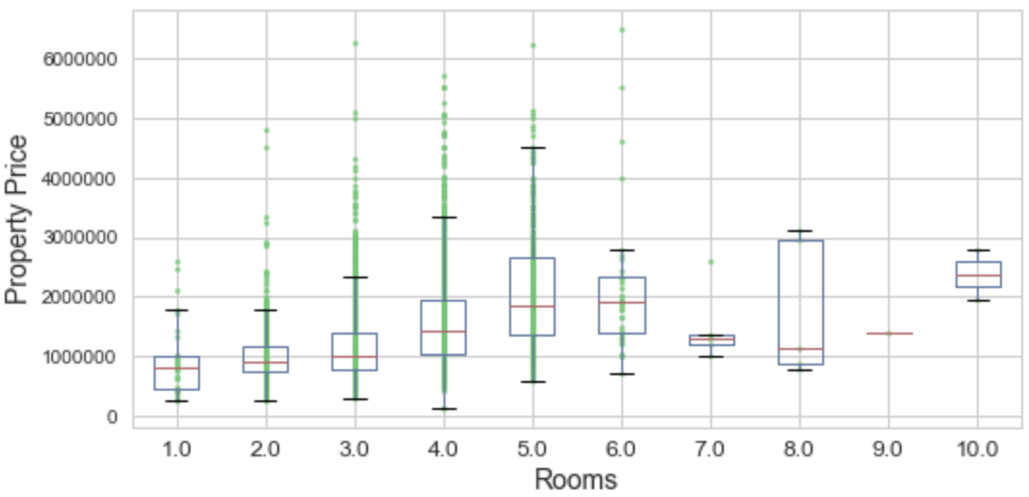
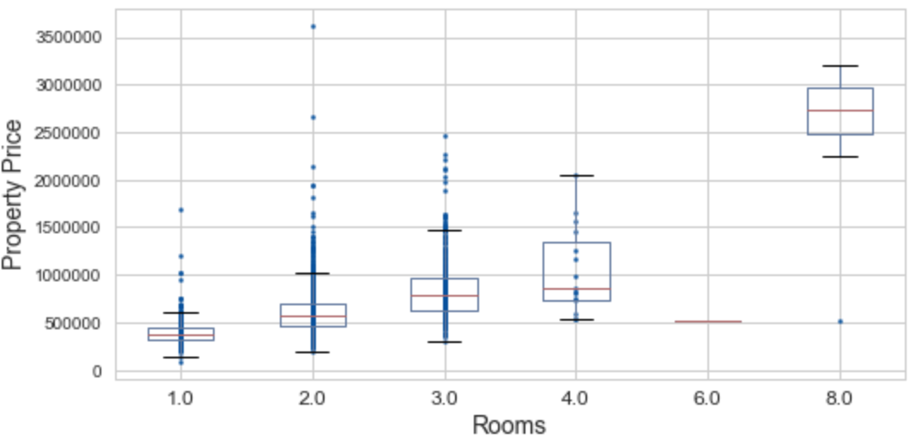
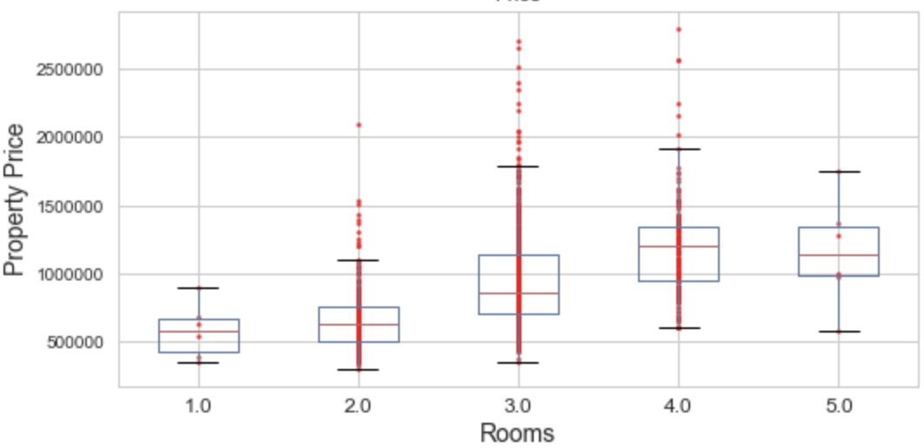
Data Visualization (Continued…)
It is evident that among the considered predictors except 'Landsize' all others have some influence over the 'Property Price'.
'Property Price’ vs 'Landsize'
'Property Price' vs ‘Property Sold Date'
'Property Price' vs 'CBD’ with ‘Region’
'Property Price' vs ‘CBD' @Central
'Property Price' vs ‘CBD' @Eastern
'Property Price' vs ‘CBD' @Western
'Property Price' vs ‘CBD' @Northern
'Property Price' vs ‘CBD' @Southern
'Property Price' vs 'Number of Cars in a Garage'
'Price' vs ‘Rooms' with PropType ‘h’
'Price' vs ‘Rooms' with PropType ‘u’
'Price' vs ‘Rooms' with PropType ‘t’

Slide 8

Regression Analysis
Stepwise regression model has been adapted
Approach – Forward selection
Significance of the variable has been measured using p-value of the t-statistic
Overall significance of the model was tested using p-value of the F-statistic
Checking of Multicollinearity after each model so that redundant variable/s can be discarded
Dummy/Categorical variables have been included in the analysis

Slide 9
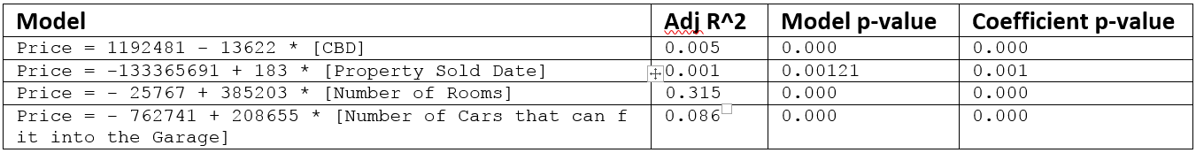
Regression model with Single predictor
OLS Result Analysis
The R^2 value is very low for all the model
Single predictor is Not significantly influencing the Property price
The Independent variable 'Property Sold Date' is grossly impacting the R-Sqr value; almost ‘Zero’ R^2 value. Moreover, with huge negative intercept value (-133365691) the 2nd model suggests that there are homes with ‘zero’ room which is meaningless.
'Property Sold Date’ cannot be considered as predictor in future model analysis.

Slide 10
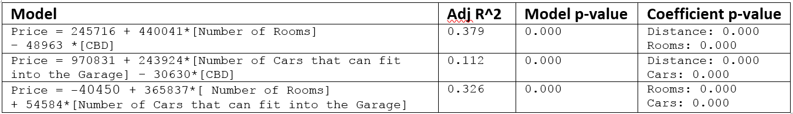
Regression model with Dual predictors
OLS Result Analysis
Comparing the Adj R^2 value the 2nd model from the above table can be discarded

Slide 11
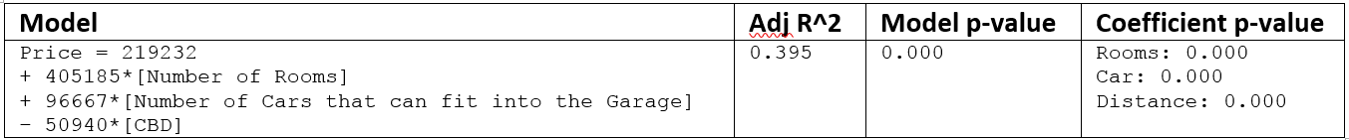

Regression model with Triple predictors
OLS Result Analysis
As expected the Adj R^2 value got improved with triple predictor variables
However, there is a possibility of Multicollinearity. The below table provides such symptom which needs further analysis

Slide 12
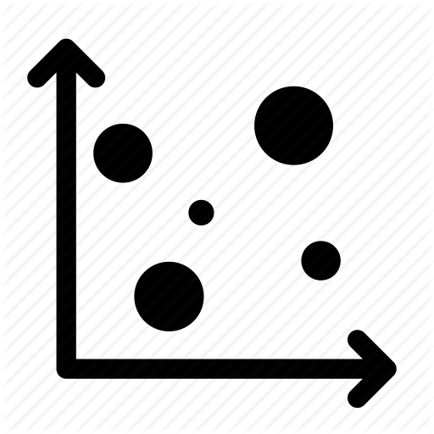
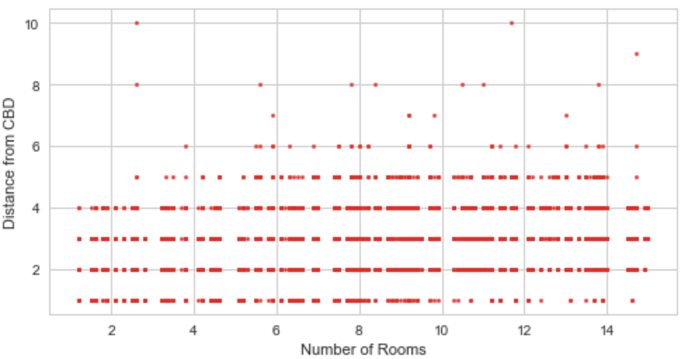
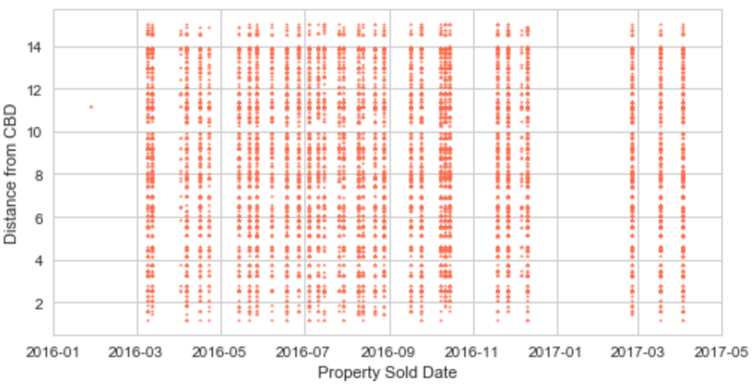
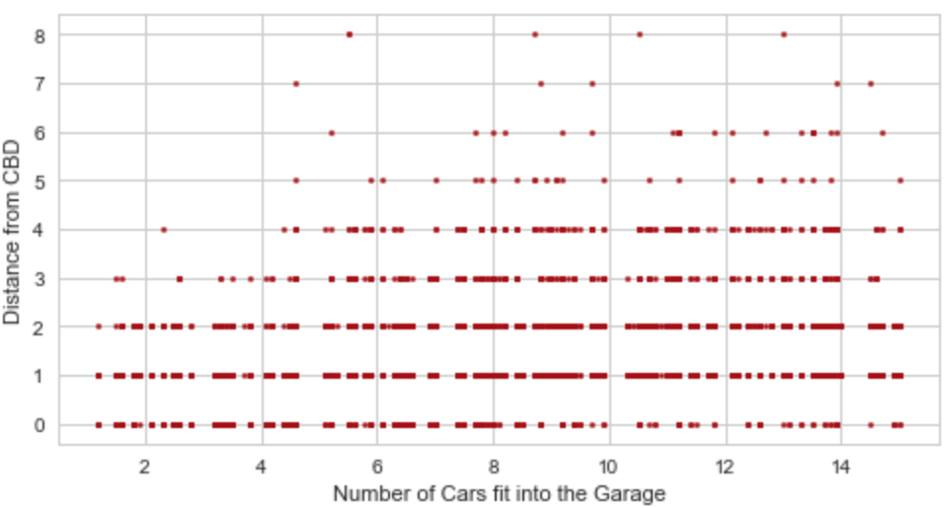
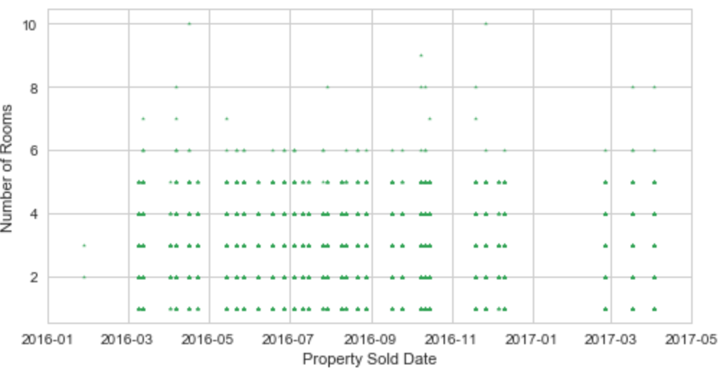
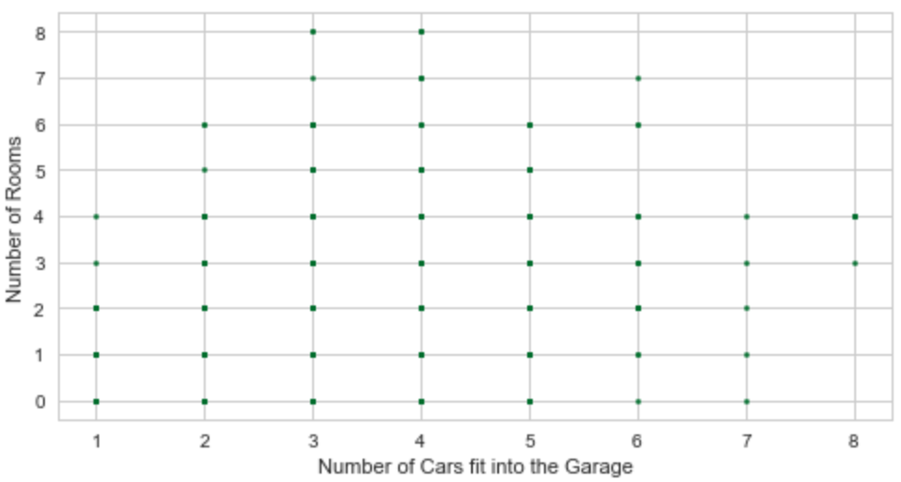
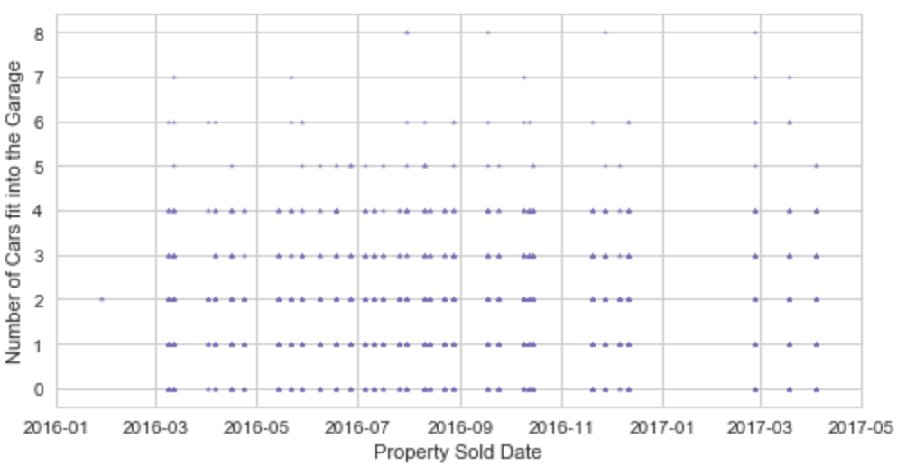
Checking Multicollinearity
‘Distance from CBD' vs ‘Number of Rooms'
‘Distance from CBD' vs ‘Property Sold Date'
‘Distance from CBD' vs ‘Number of Cars that can fit into the Garage'
‘Number of Rooms' vs ‘Property Sold Date'
‘Number of Rooms' vs ‘Number of Cars that can fit into the Garage'
‘Number of Cars that can fit into the Garage' vs ‘Property Sold Date’
The scatter plots depict NO multicollinearity between the predictors
VIF: Regressing the predictor “Number of Cars that fit into the Garage” on the remaining 2 predictors. We got VIFCars = 1.25
It appears there is hardly any variance inflation what we have otherwise anticipated from the correlation analysis between the “Number of Rooms” and the “Number of Cars that can fit into the Garage”

Slide 13
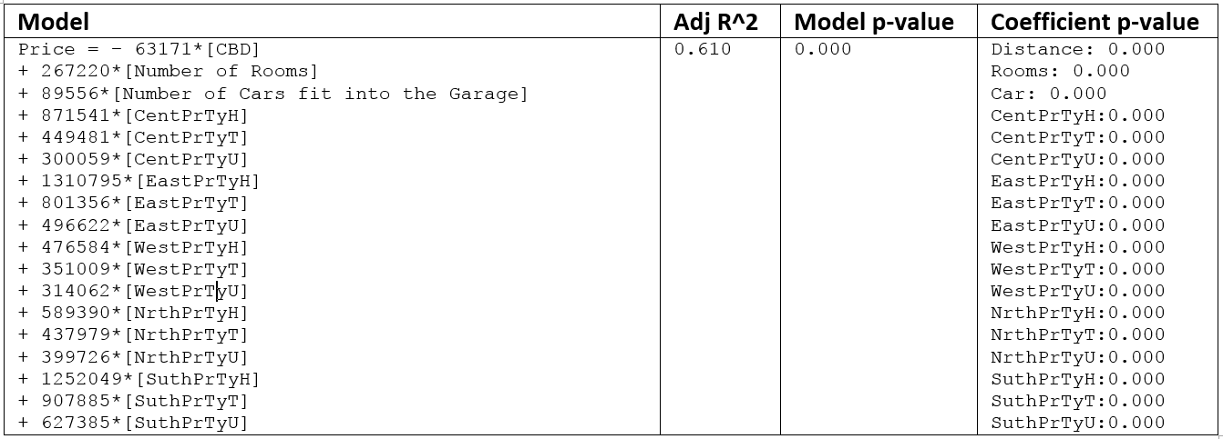
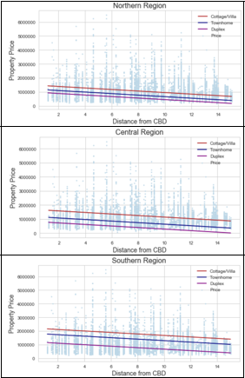
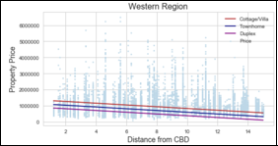
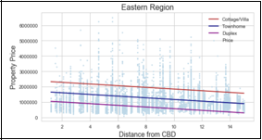
Impact of Dummy/Categorical variables
OLS Result Analysis
Across all regions the property price decreases steadily as the distance from CBD increases
Across all regions, among the properties Cottages/regular houses are the costliest and on the other-hand duplex properties are affordable.

Slide 14

Summary
The last model is the best one – fits to the dataset
Not overcrowded with non-significant predictors
Avoided “Curse of Dimensionality”
Has highest adjusted R^2 value among the models
No Multicollinearity among the selected Independent variables
Low/tend to zero p-value (< 0.05) of all predictors
Addition of categorical variables improves the Adjusted R^2 value
The model is very convenient for an outsider to predict the price of a house with some basic information.
With the estimated number, the individual would be in a better position to negotiate with the sales agent/home owner/seller before zeroed in his/her choice of house.

Slide 15

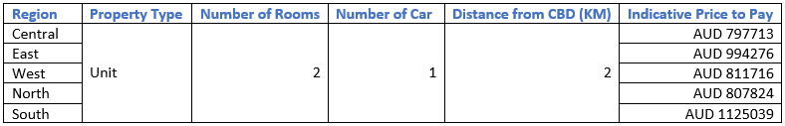
Conclusion - Important basic question?
Question: If an individual wants to get a unit with two rooms, have it within cycling distance (approx. 2 Kms) of CBD (most likely the work place), with 1 car for other purpose how much the individual might need to pay??
Answer
Clearly, the most affordable places to buy house (unit/duplex) are Northern and Central region.

Slide 16

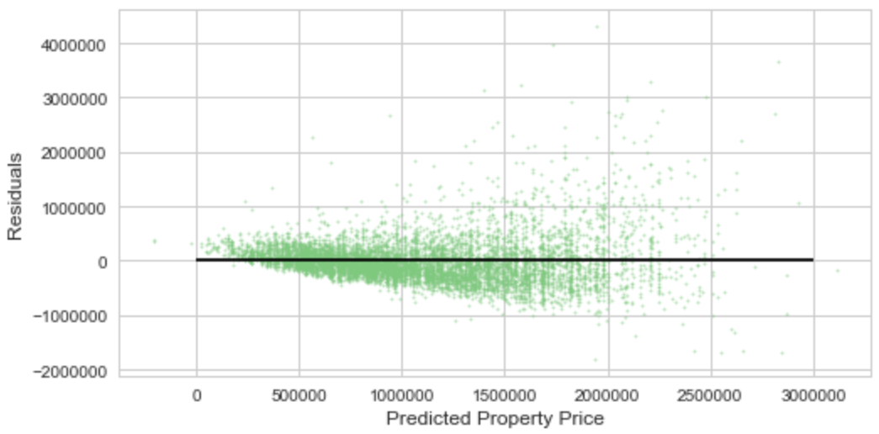
Model Diagnostics
Residual Plots
Funnel liked shape
Heteroskedasticity – the SD is small to the left of the plot and large to the right
Usual t-stat or F-stat for drawing inferences become no longer valid
Dealing with Heteroskedasticity
Use WLS (Weighted Least Squares) to calculate efficient estimators
Transforming variables
Adding significant missing variable/s; ex: building area
Applying non-linear regression model

Slide 17
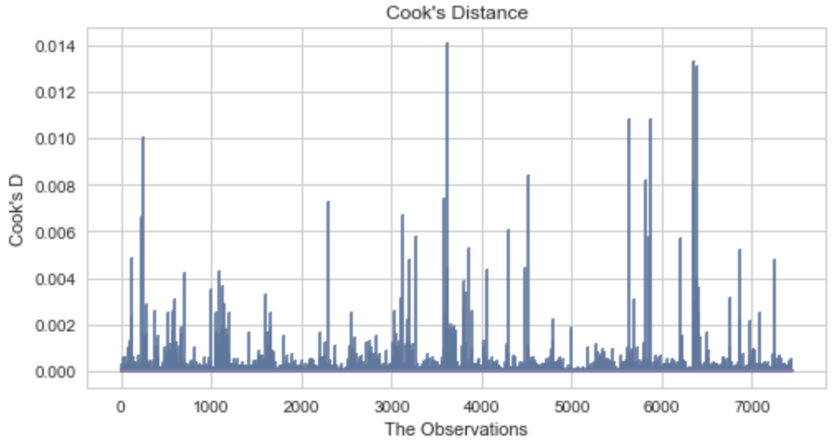
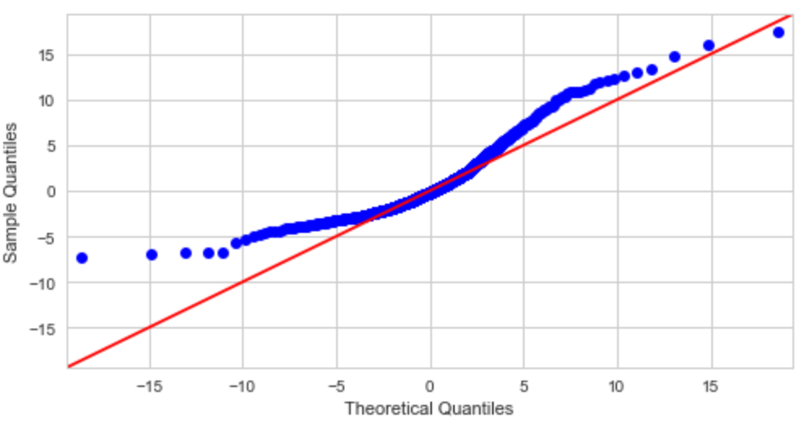
Model Diagnostics (Continued…)
Cook’s D
The Cook’s D value of all the observations is less than 1
There are very few influential, high leverage points from the considered observations of the dataset.
Quantile Plot of Residuals
The behavior indicates some degree of skewing – Left skewing

Slide 18

Future scope of improvement
The property price of Eastern and Southern regions is more expensive than the property price of Central region which is surrounding the CBD. There must be other factor/s which might be influencing the price
Unavailability of relevant data of an important predictor the ‘size of the house’. It must be included in future analysis
Outliers must be removed to avoid biasedness
Heteroskedasticity diminishes the advantages of OLS model. Need more research to come up with alternative solution so that Heteroskedasticity can be minimized.
Cross validation must be included for future analysis

Slide 19

Thanks & Acknowledgements
Would like to thank Ryan Rosario from the bottom of my heart for his advice on this capstone project, especially for suggesting various techniques and patiently listening concern/issue.
He is truly very knowledgeable and a great mentor.

